Slide 1
Project Title: Wave-Based Computation Using Dynamic Liquid Media and Quantum Simulation
Team Name: Quantum Minds
Mentor: Dr. S. Mohamed Nizar(AP)ECE
Institution: Rajalakshmi Institute Of Technology(RIT)
Team Members:
Akash S
Harish Ganapathy S
Ramya S

Slide 2
Work Completed (Week 4)
Finalized hardware components for the prototype.
Designed the hardware architecture.
Studied Raspberry Pi software environment.
Defined the software workflow.
Finalized LiDAR data processing pipeline.
Planned Qiskit integration.
Prepared prototype implementation plan.

Slide 3
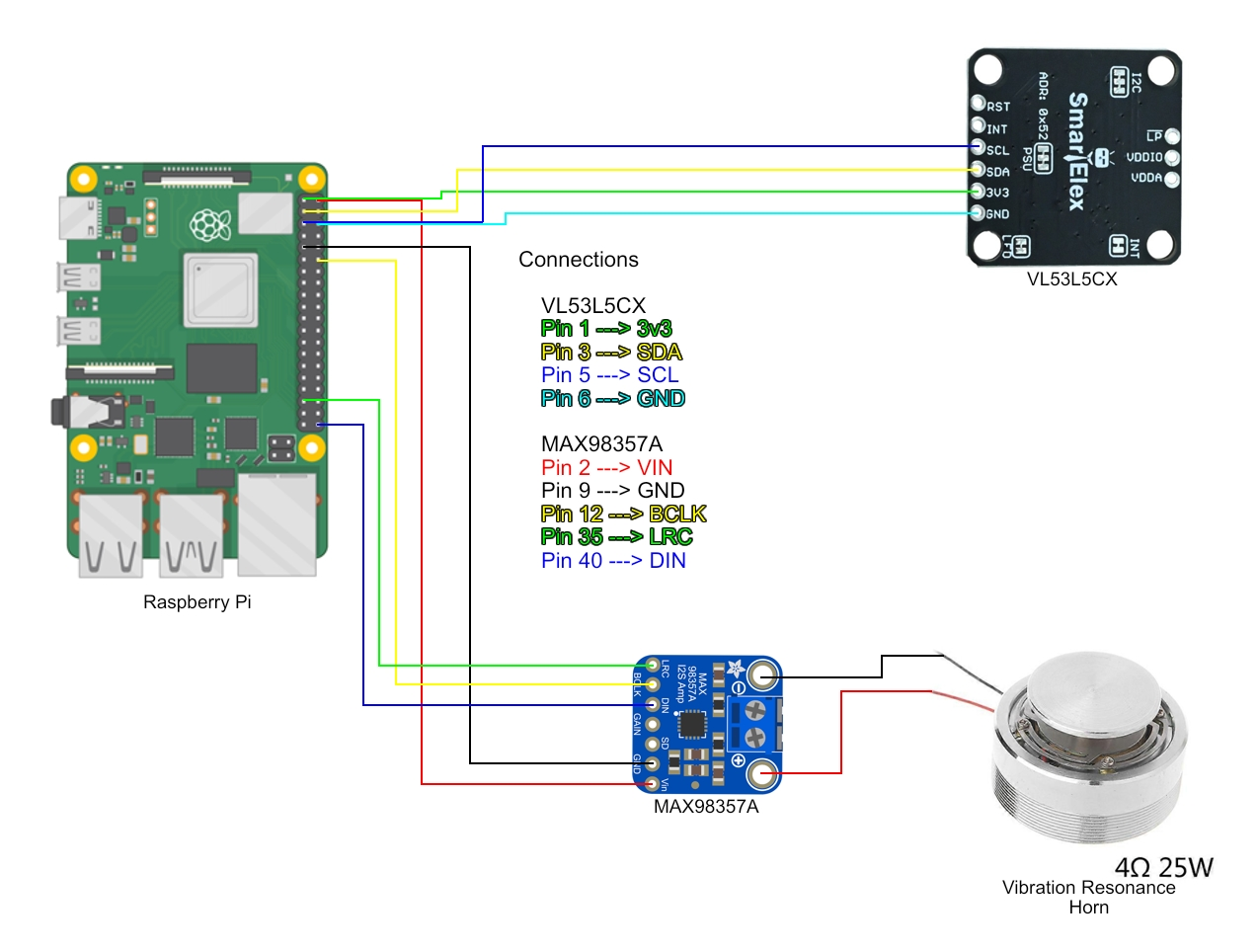
Hardware Architecture

Slide 4
Raspberry Pi Software Workflow
Raspberry Pi OS (Linux)
Python Programming
I²C communication with VL53L5CX
Read 8×8 distance matrix
Process obstacle information
Generate Quantum Random Number using Qiskit
Send vibration signal through I²S
LiDAR Sensor

Slide 5
Data Flow
LiDAR Sensor
↓
8×8 Distance Matrix
↓
Data Preprocessing
↓
Feature Extraction
↓
Qiskit Quantum Simulation
↓
Decision Logic
↓
MAX98357A
↓
Vibration Feedback

Slide 6
Who Did What?
Harish Ganapathy
Finalized hardware architecture.
Prepared circuit design.
Ramya S
Studied Raspberry Pi interfacing.
Prepared hardware specifications.
Akash S
Designed software workflow.
Planned data preprocessing.
Studied feature extraction.
Researched Qiskit integration

Slide 7
Current Status
 | Completed Tasks Literature Survey Hardware Selection Software Design Circuit Design Pending Tasks Hardware Purchase Prototype Assembly System Testing

Slide 8
Next Week Plan
Purchase hardware components.
Assemble the prototype.
Interface LiDAR with Raspberry Pi.
Read real-time sensor data.
Begin software implementation.
Integrate Qiskit simulation.

Slide 9
Expected Outcome
Working Raspberry Pi prototype.
Real-time obstacle detection.
Quantum-assisted software pipeline.
Initial hardware validation.

Slide 10


